Slide 1
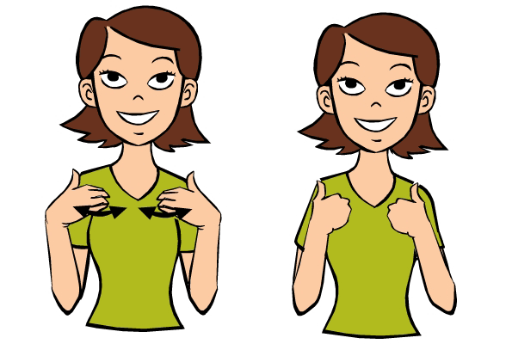
ANIMAL
All photo credit: www.babysignlanguage.com

Slide 2
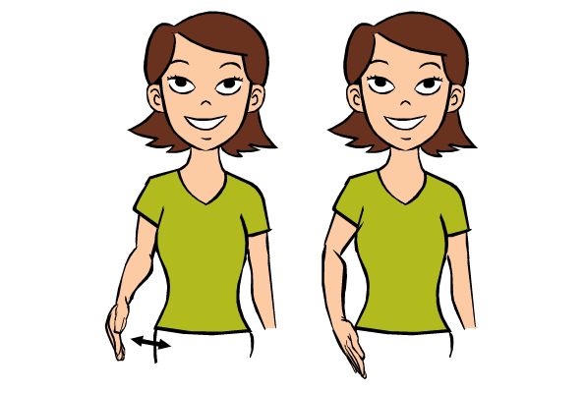
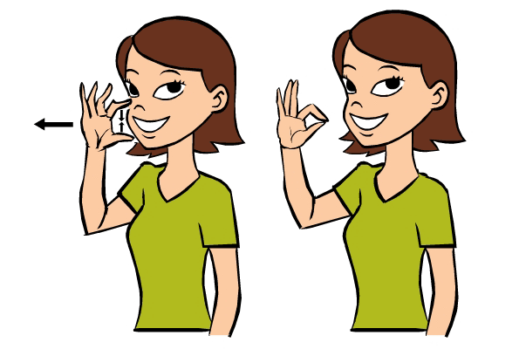
DOG
CAT
All photo credit: www.babysignlanguage.com

Slide 3
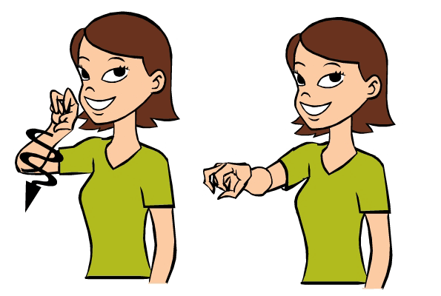
FISH
SNAKE
All photo credit: www.babysignlanguage.com

Slide 4
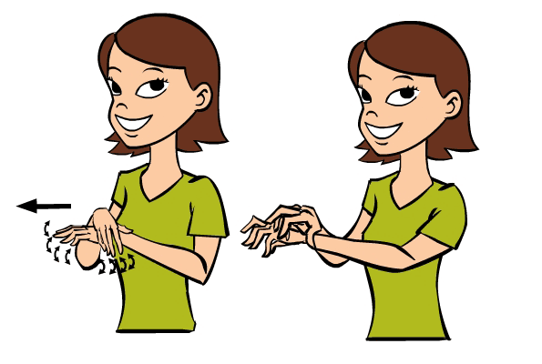
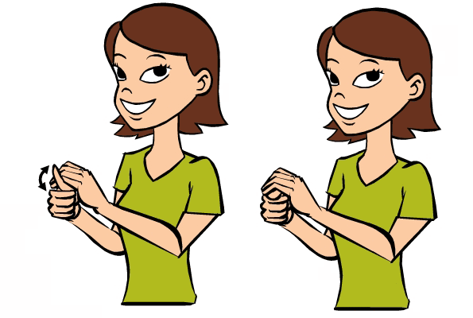
TURTLE
SPIDER
All photo credit: www.babysignlanguage.com

Slide 5
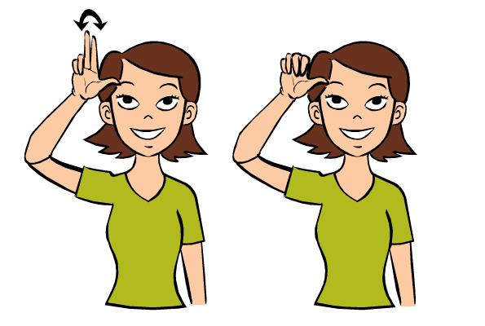
RABBIT
HORSE
All photo credit: www.babysignlanguage.com

Slide 6
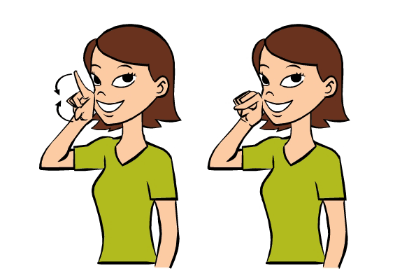
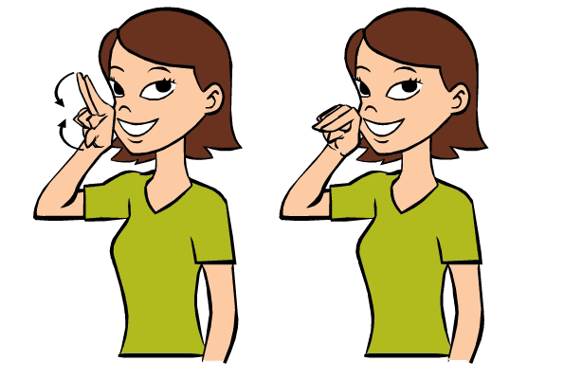
BIRD
DUCK
All photo credit: www.babysignlanguage.com

Slide 7
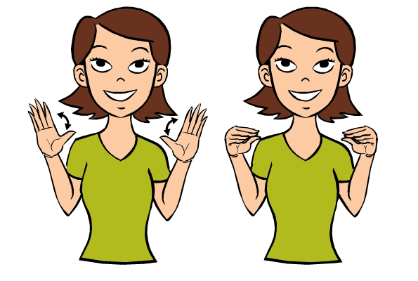
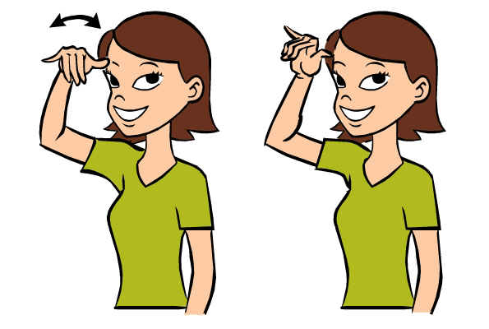
CRAB
COW
All photo credit: www.babysignlanguage.com

Slide 8
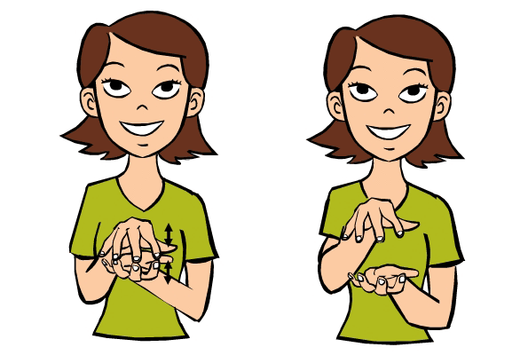
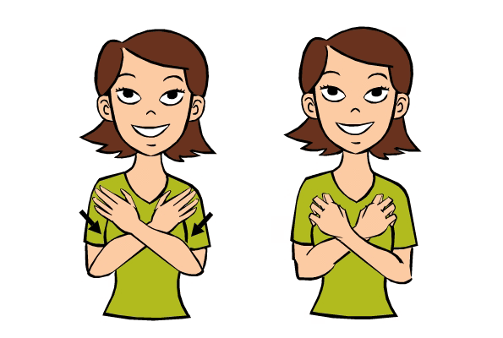
ALLIGATOR
BEAR
All photo credit: www.babysignlanguage.com

Slide 9
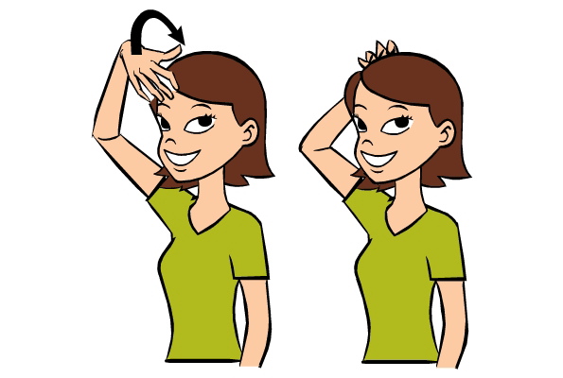
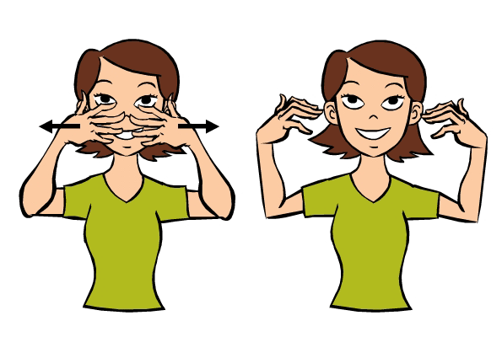
LION
TIGER
All photo credit: www.babysignlanguage.com

Slide 10
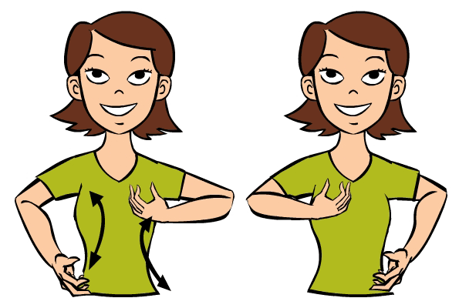
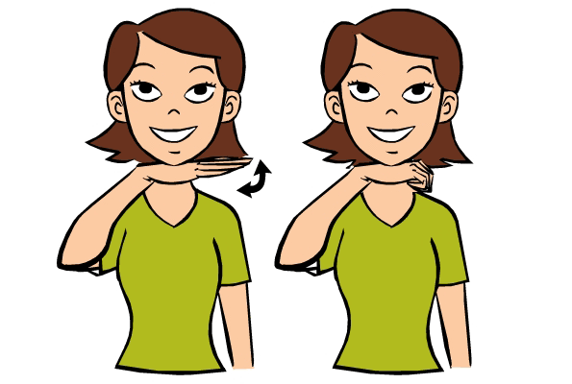
MONKEY
PIG
All photo credit: www.babysignlanguage.com

